Slide 1
Project Rio Technical Briefing Sessions
Outwards Reinsurance
24th February 2022
Lyndsay Deeves, Dominic Thomas and Keely Edwards

Slide 2
Agenda
Agenda Item |  | Timings
1. | Oversight framework overview – what is it and how will it work? - Overview of the broader framework - How will it work for outwards reinsurance? | 25 mins 15mins
2. | Case studies – bringing the framework to life | 25 mins
3. | Self Assessments | 5 mins
4. | Next steps | 5 mins
5. | Q&A | 15 mins

Slide 3
Oversight Framework:
Overview of broader framework
Lyndsay Deeves
Pre-recorded

Slide 4
Oversight Framework
Focussing on what matters
Providing the best run syndicates the space to grow, whilst ensuring appropriate and proportionate oversight across businesses performing poorly against Lloyd’s financial and non-financial expectations
Oversight Objectives
1. Lloyd’s oversight supports the delivery of the Lloyd’s strategy
2. Lloyd’s oversight is aligned with the Risk Appetite set by the Council
3. Lloyd’s oversight instils confidence in regulators and rating agencies
4. Lloyd’s oversight creates the conditions for good business to thrive
5. Lloyd’s oversight is decisive and impactful for substandard managing agents
6. Lloyd’s places primary responsibility for oversight on managing agents’ boards and management
7. Lloyd’s oversight is risk-based and proportionate
8. Lloyd’s oversight is holistic and joined up
9. Lloyd’s oversight is objective and data driven

Slide 5
Oversight Framework
Three interlinking elements that work together to support more differentiated and impactful oversight
One consistent approach to syndicate and agent categorisation based on assessment against Principles on a qualitative and quantitative basis
Principles defined across all oversight areas
PERFORMANCE
1. Underwriting Profitability
2. Catastrophe Exposure
Syndicate categorisation
3. Outwards Reinsurance
4. Claims Management
5. Customer Outcomes
6. Reserving
SOLVENCY
7. Capital
Principles for doing business at Lloyd’s
8. Investment
Growth and development opportunities for the best run businesses
9. Liquidity
Oversight and interventions
Development opportunities
OPERATIONAL
10. Governance, Risk Management and Reporting
11. Regulatory and Financial Crime
12. Operational resilience
An escalating scale of interventions that are linked to principles and overall syndicates categorisation
13. Culture

Slide 6
Oversight Framework
Three interlinking elements that work together to support more differentiated and impactful oversight
One consistent approach to syndicate and agent categorisation based on assessment against Principles on a qualitative and quantitative basis
Principles defined across all oversight areas
PERFORMANCE
1. Underwriting Profitability
2. Catastrophe Exposure
Syndicate categorisation
3. Outwards Reinsurance
4. Claims Management
5. Customer Outcomes
6. Reserving
SOLVENCY
7. Capital
Principles for doing business at Lloyd’s
8. Investment
Growth and development opportunities for the best run businesses
9. Liquidity
Oversight and interventions
Development opportunities
OPERATIONAL
10. Governance, Risk Management and Reporting
11. Regulatory and Financial Crime
12. Operational resilience
An escalating scale of interventions that are linked to principles and overall syndicates categorisation
13. Culture

Slide 7
Oversight Framework
Three interlinking elements that work together to support more differentiated and impactful oversight
One consistent approach to syndicate and agent categorisation based on assessment against Principles on a qualitative and quantitative basis
Principles defined across all oversight areas
PERFORMANCE
1. Underwriting Profitability
2. Catastrophe Exposure
Syndicate categorisation
3. Outwards Reinsurance
4. Claims Management
5. Customer Outcomes
6. Reserving
SOLVENCY
7. Capital
Principles for doing business at Lloyd’s
8. Investment
Growth and development opportunities for the best run businesses
9. Liquidity
Oversight and interventions
Development opportunities
OPERATIONAL
10. Governance, Risk Management and Reporting
11. Regulatory and Financial Crime
12. Operational resilience
An escalating scale of interventions that are linked to principles and overall syndicates categorisation
13. Culture

Slide 8
Oversight Framework
Three interlinking elements that work together to support more differentiated and impactful oversight
One consistent approach to syndicate and agent categorisation based on assessment against Principles on a qualitative and quantitative basis
Principles defined across all oversight areas
PERFORMANCE
1. Underwriting Profitability
2. Catastrophe Exposure
Syndicate categorisation
3. Outwards Reinsurance
4. Claims Management
5. Customer Outcomes
6. Reserving
SOLVENCY
7. Capital
Principles for doing business at Lloyd’s
8. Investment
Growth and development opportunities for the best run businesses
9. Liquidity
Oversight and interventions
Development opportunities
OPERATIONAL
10. Governance, Risk Management and Reporting
11. Regulatory and Financial Crime
12. Operational resilience
An escalating scale of interventions that are linked to principles and overall syndicates categorisation
13. Culture

Slide 9
Oversight Framework
The Lloyd’s Principles
One consistent approach to syndicate and agent categorisation based on assessment against Principles on a qualitative and quantitative basis
Syndicate categorisation
Principles for doing business at Lloyd’s
Growth and development opportunities for the best run businesses
Oversight and interventions
Development opportunities
An escalating scale of interventions that are linked to principles and overall syndicates categorisation

Slide 10
Oversight Framework
The 13 Lloyd’s Principles
PERFORMANCE
1. Underwriting Profitability
Managing agents should produce and execute syndicate business plans which are logical, realistic and achievable, and ensure the delivery of a sustainable profit including expense management.​
SOLVENCY
7. Capital
Managing agents should ensure syndicates' Solvency Capital Requirement (SCR) appropriately reflects their risk profile and is calculated using a Solvency II compliant internal model.
8. Investment
Managing agents should ensure syndicate investment risk is effectively controlled, informed by wider business strategy and adheres to the Prudent Person Principle (PPP) requirements​.​
2. Catastrophe Exposure
Managing agents should ensure syndicates maintain appropriate control of catastrophe risk (from natural and non-natural perils) in line with their wider business strategy.
9. Liquidity
Managing agents should ensure syndicates have contractual access to sufficient liquidity in order to withstand a severe liquidity event (defined by Lloyd’s), underpinned by a robust liquidity risk management framework​. ​​​
3. Outwards Reinsurance
Managing agents should define and execute syndicate outwards reinsurance strategy and purchasing plans which effectively support the wider syndicate business strategy and objectives.
OPERATIONAL
10. Governance, Risk Management and Reporting
Managing agents should have governance structures and internal risk management and control frameworks in place which align to Solvency II requirements, enable sound and prudent management of the business and support delivery of the business strategy​.
4. Claims Management
Managing agents should ensure that they have a claims commitment in place which is designed to deliver a high-quality claims service which includes a prompt and fair customer service, efficient and effective claims handling, and compliance with legal and regulatory obligations.
11. Regulatory and Financial Crime
Managing agents should have robust frameworks in place to assess and address regulatory and financial crime risks arising from their UK and international businesses. Frameworks should support compliance with law, regulation and guidance, and allow for well informed, transparent relationships with Lloyd’s and applicable regulators.
5. Customer Outcomes
Managing agents should embed a culture and associated behaviours throughout their business to ensure that they consistently focus on good customer outcomes and that products provide fair value.
12. Operational resilience
Managing agents should maintain robust and resilient operations, embedding cyber resilience and effective third-party risk management​.
6. Reserving
Managing agents should ensure syndicates set reserves which are underpinned by a robust reserving process. All Actuarial Function requirements should be met in line with Solvency II.
13. Culture
Managing agents should be diverse, creating an inclusive and high-performance culture. h

Slide 11
Oversight Framework
Principles and Sub-Principles
Principle
Sub-Principles
2. Catastrophe Exposure
Managing agents should ensure syndicates maintain appropriate control of catastrophe risk (from natural and non-natural perils) in line with their wider business strategy.
To support this, managing agents should ensure their syndicates:​
1
Manage catastrophe exposure in line with their agreed risk appetites
2
Employ data standards, risk quantification tools, controls, expertise, and reporting frameworks which are appropriate to their risk profile
3
Adequately justify and validate methodology and assumptions, including expert judgements
4
Have a complete representation of catastrophe risk in the internal model, reflecting all possible sources of loss and allowing effective use by wider business functions
5
Have robust governance and oversight of risk aggregations

Slide 12
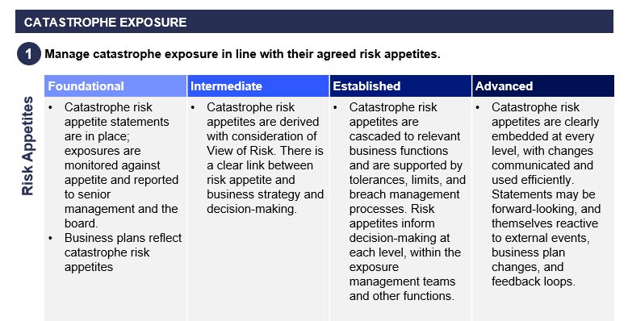
Oversight Framework
The Maturity Matrices
Maturity Matrix
Materiality to the Principles informs expected sophistication
Sub Principle
Indicators & suggestions – not requirements
Foundational broadly aligns with the expectations from the previous minimum standards
Guidance
Read from left to right, as the guidance at one level can be understood as the starting point for the next.
Low materiality
Moderate materiality
High materiality
Highest materiality

Slide 13
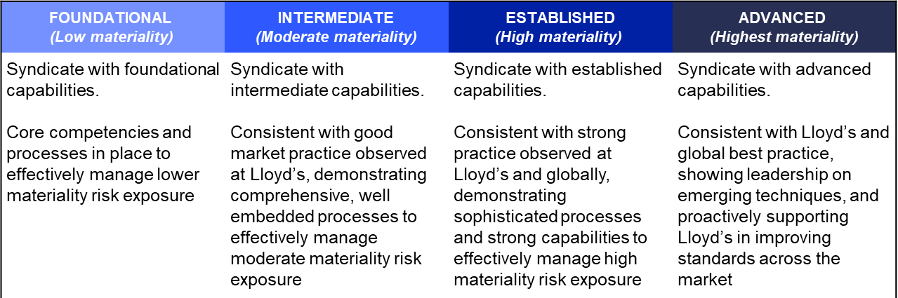
Oversight Framework
Levels of maturity – generic definitions

Slide 14
Oversight Framework
Syndicate categorisation
One consistent approach to syndicate and agent categorisation based on assessment against Principles on a qualitative and quantitative basis
Syndicate categorisation
Principles for doing business at Lloyd’s
Growth and development opportunities for the best run businesses
Oversight and interventions
Development opportunities
An escalating scale of interventions that are linked to principles and overall syndicates categorisation

Slide 15
Oversight Framework
Syndicate categorisation
Oversight Dimensions |  | Expected Maturity
Performance | Underwriting Profitability | Advanced
 | Catastrophe Exposure | Established
 | Outwards Reinsurance | Foundational
 | Claims Management | Intermediate
 | Customer Outcomes | Intermediate
 | Reserving | Advanced
Solvency | Capital | Established
 | Investments | Established
 | Liquidity | Foundational
Operational | Governance, Risk Management and Reporting | Established
 | Regulatory and Financial Crime | Intermediate
 | Operational Resilience | Foundational
 | Culture | Foundational

Slide 16
Oversight Framework
Syndicate categorisation
Oversight Dimensions |  | Expected Maturity | Actual Maturity | Dimension Rating
Performance | Underwriting Profitability | Advanced | Intermediate | Below expectations
 | Catastrophe Exposure | Established | Established | Meets expectations
 | Outwards Reinsurance | Foundational | Foundational | Meets expectations
 | Claims Management | Intermediate | Foundational | Marginally below expectations
 | Customer Outcomes | Intermediate | Foundational | Marginally below expectations
 | Reserving | Advanced | Advanced | Meets expectations
Solvency | Capital | Established | Foundational | Below expectations
 | Investments | Established | Established | Meets expectations
 | Liquidity | Foundational | Foundational | Meets expectations
Operational | Governance, Risk Management and Reporting | Established | Foundational | Below expectations
 | Regulatory and Financial Crime | Intermediate | Intermediate | Meets expectations
 | Operational Resilience | Foundational | Foundational | Meets expectations
 | Culture | Foundational | Foundational | Meets expectations

Slide 17
Oversight Framework
Dimension Rating
Meets expectation
Marginally below expectation
Below expectation
Well below expectation
Syndicate categorisation
Oversight Dimensions |  | Expected Maturity | Actual Maturity | Dimension Rating |  | Syndicate Category
Performance | Underwriting Profitability | Advanced | Intermediate | Below expectations |  | UNDERPERFORMING
 | Catastrophe Exposure | Established | Established | Meets expectations
 | Outwards Reinsurance | Foundational | Foundational | Meets expectations
 | Claims Management | Intermediate | Foundational | Marginally below expectations
 | Customer Outcomes | Intermediate | Foundational | Marginally below expectations
 | Reserving | Advanced | Advanced | Meets expectations
Solvency | Capital | Established | Foundational | Below expectations
 | Investments | Established | Established | Meets expectations
 | Liquidity | Foundational | Foundational | Meets expectations
Operational | Governance, Risk Management and Reporting | Established | Foundational | Below expectations
 | Regulatory and Financial Crime | Intermediate | Intermediate | Meets expectations
 | Operational Resilience | Foundational | Foundational | Meets expectations
 | Culture | Foundational | Foundational | Meets expectations

Slide 18
Oversight Framework
Dimension Rating
Meets expectation
Marginally below expectation
Below expectation
Well below expectation
Syndicate categorisation
Oversight Dimensions |  | Expected Maturity | Actual Maturity | Dimension Rating |  | Syndicate Category
Performance | Underwriting Profitability | Advanced | Intermediate | Below expectations |  | UNDERPERFORMING
 | Catastrophe Exposure | Established | Established | Meets expectations
 | Outwards Reinsurance | Foundational | Foundational | Meets expectations
 | Claims Management | Intermediate | Foundational | Marginally below expectations
 | Customer Outcomes | Intermediate | Foundational | Marginally below expectations
 | Reserving | Advanced | Advanced | Meets expectations
Solvency | Capital | Established | Foundational | Below expectations
 | Investments | Established | Established | Meets expectations
 | Liquidity | Foundational | Foundational | Meets expectations
Operational | Governance, Risk Management and Reporting | Established | Foundational | Below expectations
 | Regulatory and Financial Crime | Intermediate | Intermediate | Meets expectations
 | Operational Resilience | Foundational | Foundational | Meets expectations
 | Culture | Foundational | Foundational | Meets expectations
OUTPERFORMING
GOOD
MODERATE
UNDERPERFORMING
UNACCEPTABLE

Slide 19
Oversight Framework
Oversight / Interventions and Development Opportunities
One consistent approach to syndicate and agent categorisation based on assessment against Principles on a qualitative and quantitative basis
Syndicate categorisation
Principles for doing business at Lloyd’s
Growth and development opportunities for the best run businesses
Oversight and interventions
Development opportunities
An escalating scale of interventions that are linked to principles and overall syndicates categorisation

Slide 20
Oversight Framework
Interventions Playbook
Robust intervention for underperformers
Development encouraged for the best
Overall syndicate categorisation | Unacceptable | Underperforming | Moderate | Good | Outperforming
 | Capability and performance well below expectations with all avenues to remediate exhausted Immediate action required Full range of Interventions used | Capability and performance below expectations Robust intervention taken Rapid remediation with close monitoring and escalation | Capability and performance marginally below expectations Targeted oversight into higher risk areas Moderate Interventions in place | Capability and performance in line with expectations Targeted monitoring / oversight Minimal intervention | Capability in line with expectations and supported by Best in class performance Highly targeted / reduced oversight Interventions by exception
Overall Interventions | Execute approved run off plan Appoint new Managing Agent | Instruct independent reviews Remediation plan in place, with senior management Quarterly check-in with Board on progress against remediation plan Regulators notified Restrict development, subject to completion of remedial actions Increased frequency of Principles attestations Increased reporting and escalation to governance Committees Contingent run-off plan in place | Increased Account Manager and ELG engagement to ensure higher risk areas being remediated Development only supported in areas where justified New syndicates not supported until higher risk areas remediated | Option for file and use plan if demonstrated to be Logical, Realistic and Achievable Proactive Development support and Account Management, including supporting establishing new syndicates/SPA/SIAB Engagement more weighted towards development than oversight | File and Use business plans (subject to safeguards) Light capital reviews (subject to safeguards) No New Syndicate Load applied Proactive Development support and Account Management, including supporting establishing new syndicates/SPA/SIAB Cat Risk Appetite “Flex” permitted – more generous capitalisation rates in terms of any LCM5 CRA year-on-year growth Reduced involvement in thematic review except where best practice view is desired Inclusion of managing agents in key working groups which shape the market Promote in external campaigns
Notes:
No new interventions – same toolkit as before, but more transparency and consistency
Interventions playbook isn’t a checklist
Process for appeal

Slide 21
Oversight Framework:
How will it work for outwards reinsurance?
Keely Edwards

Slide 22
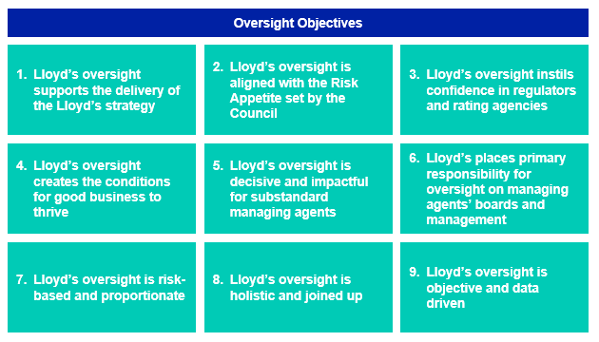
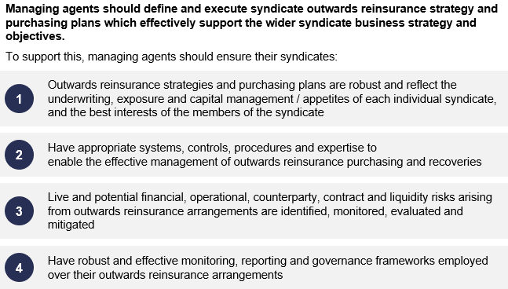
Oversight Framework – Outwards Reinsurance
What risk are we managing?
The aim of Lloyd’s, and the Outwards Reinsurance team, is to understand the risks to Lloyd’s and individual syndicates arising from the scale, nature, quality and concentration of reinsurance purchased by syndicates.
We want to minimise the likelihood of reinsurance failure and avoid any undue risk to Lloyd’s performance and solvency position, and protect Lloyd’s Financial Strength Rating.
Outwards reinsurance is not a ‘risk-free’ transaction and we would expect syndicates to have effective management and control processes, appropriate for their level of reinsurance risk. This has led to the four sub-principles.

Slide 23
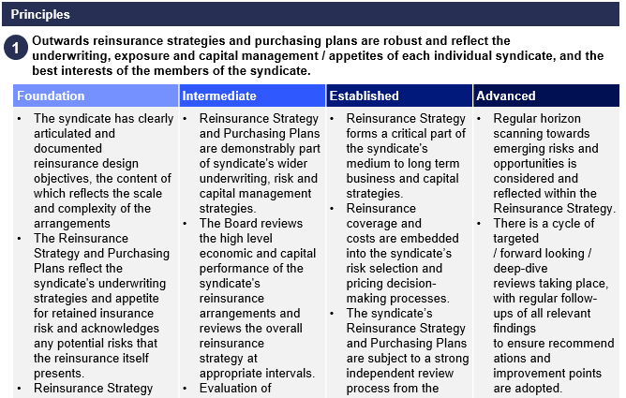
Oversight Framework - Outwards Reinsurance
Calculating Materiality and defining expected Maturity
Dimension | Materiality measure | Low Foundational | Moderate Intermediate | High Established | Highest Advanced
Principle 3: | YOA Reinsurance Premium as Percentage of Gross Written Premium | <40% | >=40% | >=50% | >=75%
Outwards Reinsurance | YOA Largest Absolute Maximum Line Size Reinsurance Transfer as percentage of ECA | <75% | >=75% | >=100% | >=300%
 | Balance Sheet Reinsurance Recoverables as percentage of Balance Sheet Assets | <40% | >=40% | >=50% | >=75%
 | LCR Reinsurance Recoveries at the 1:200 as percentage of ECA | <200% | >=200% | >=300% | >=500%
 | LCM5 AEP Reinsurance Recoveries at the 1:200 as percentage of ECA | <75% | >=75% | >=100% | >=300%
 | YOA Reinsurance Recoveries as percentage of Gross Loss | <40% | >=40% | >=50% | >=75%
No change to the thresholds we already use to identify key risk features.
No change to the expectation that syndicate’s need to have management and control processes appropriate for their level of reinsurance risk.
Six key features are used to assess materiality, the maximum of which will determine the overall level, which will inform the expected maturity. For example, a ‘high’ materiality rating leads to an expected maturity of ‘established’.
In line with risk-based approach, more time will be spent discussing and understanding risks with the higher materiality syndicates.

Slide 24
Oversight Framework - Outwards Reinsurance
How to assess performance against the Principles?
Assessment against Principles will be through combination of quantitative and qualitative
1) Quantitative assessment
Secondary strength metrics will be considered, such as:
performance of reinsurance compared to plan
financial strength of reinsurers (in-force and balance)
reported reinsurance aged debt
Quantitative assessments are inherently lagging indicators. Much of what we aim to do is to minimise risk and impact of reinsurance failure - if we wait for a syndicate’s reporting to indicate that there is a problem then that’s too late so we will also need to use Qualitative assessment.
2) Qualitative assessment
Self-assessments – used to understand syndicate’s own view of reinsurance risk and how it is being managed.
Additional metrics may be used as indicators for further conversation, such as:
volume of shared and/or related party reinsurance
sustainability of reinsurance loss ratios
level of reinsurance ceding commissions
consistency and accuracy of reporting
reinsurer concentration and/or reinsurance credit risk
Syndicate specific oversight will apply where the self-assessment does not indicate maturity appropriate for materiality
Will consider factors which may not be evident in the metrics such as new or pending acquisitions.

Slide 25
Oversight Framework – Outwards Reinsurance
Interventions specific to Outwards Reinsurance

Slide 26
Oversight Framework – Outwards Reinsurance
Annual cycle of activity
Q4
Q1
Q2
'Lockdown' of ratings for Business Planning
Q3
Principles used to support Business Planning process
Maturity self assessment submissions
Feedback to managing agents of maturity ratings
Updates to framework defined and communicated for following year
There will be continuous quantitative and qualitative assessment of materiality and maturity and data accuracy through the year based on Lloyd's interactions with Managing Agents, syndicate returns (such as QMA, QMB, SRS, RDS) and document review.

Slide 27
Case studies
Bringing the Framework to life
Dominic Thomas

Slide 28
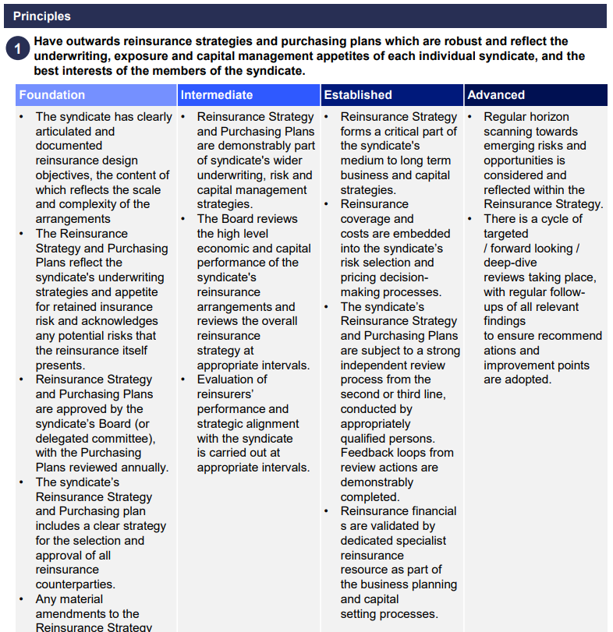
Case Study 1: Syndicate X
Syndicate X – Sub-Principle 1
Perceived Outcomes
Syndicate's Reinsurance Strategy and Purchasing Plans are subject to a strong independent review process with senior management involved pre- and post-placement.
How do we know this?
Strong knowledge of Outwards Reinsurance placements as part of regular discussions with senior management. Syndicate Performance Managers report that purchases are discussed as part of their regular meetings and provide meeting packs that closely align to the purchasing strategy discuss with the syndicate's Outwards Reinsurance team.
Actuarial review is presented to the Lloyd's ORI team as part of wash-up meetings showing the differences between the planned structures and those purchased.
Managing Agent rating
Expected Maturity – Intermediate
Actual Maturity - Established

Slide 29
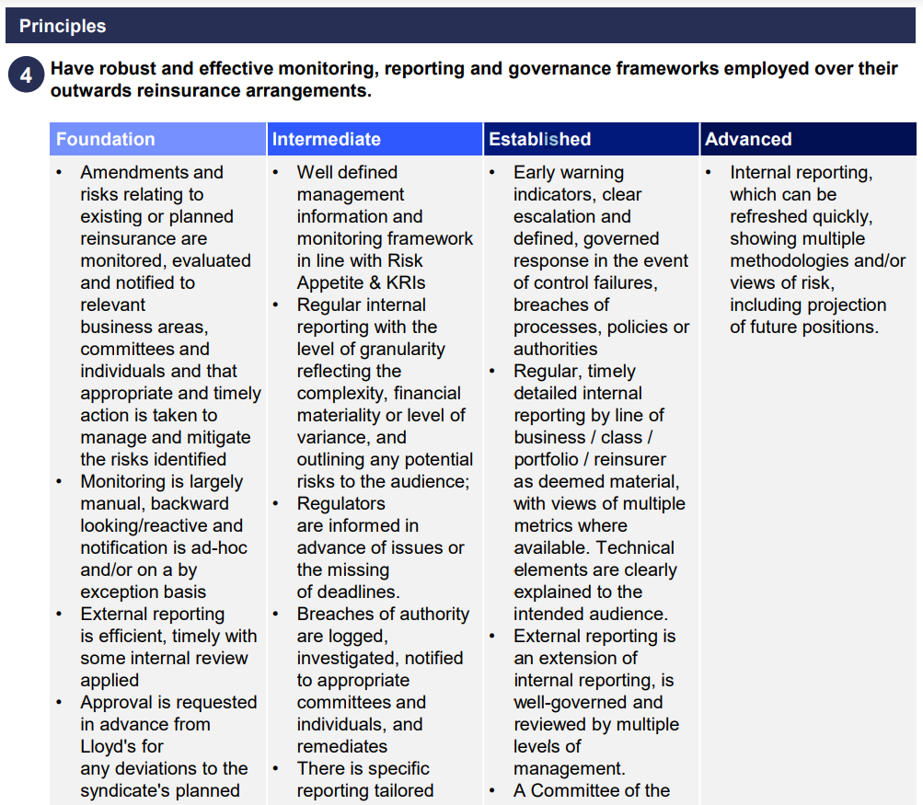
Case Study: Syndicate X
Syndicate X – Sub-Principle 4
Perceived outcomes
External reporting is efficient, timely and seemingly accurate but is not reviewed by multiple levels of management.
How do we know this?
Whilst the QMA 710 returns are accurately completed there is a lack of communication between the ORI team and senior management.
Aged Debt over 6 months continues to grow materially including with sub-A rated entities. When asked about this senior management is unaware of the issues or the cause. Upon investigation it emerges that the Aged Debt monitoring is not being escalated when triggering KRIs.
Managing Agent rating
Expected Maturity – Intermediate
Actual Maturity - Foundation

Slide 30
Case Study 1: Syndicate X
Principle |  | Expected Maturity | Assessment of Agent Maturity
3. Outwards Reinsurance Managing agents should define and execute syndicate outwards reinsurance strategy and purchasing plans which effectively support the wider syndicate business strategy and objectives. To support this, managing agents should ensure their syndicates': |  | Intermediate | Intermediate
Sub Principle 1 | Outwards reinsurance strategies and purchasing plans are robust and reflect underwriting, exposure and capital management / appetites of each individual syndicate, and the best interests of the members of the syndicate. | Intermediate | Established
Sub Principle 2 | Have appropriate systems, controls, procedures and expertise to enable the effective management of outwards reinsurance purchasing and recoveries. | Intermediate | Intermediate
Sub Principle 3 | Live and potential financial, operational, counterparty, contract and liquidity risks arising from outwards reinsurance arrangements are identified, monitored, evaluated and mitigated. | Intermediate | Intermediate
Sub Principle 4 | Have robust and effective monitoring, reporting and governance frameworks employed over their outwards reinsurance arrangements. | Intermediate | Foundational
Overall Rationale
Syndicate X's senior management has a strong understanding of the ORI strategy and Purchasing Plan but is not keeping this standard across the full operational life-cycle of the purchased cover.
Overall, an Intermediate level is appropriate at this time and the syndicate meets expectations.

Slide 31
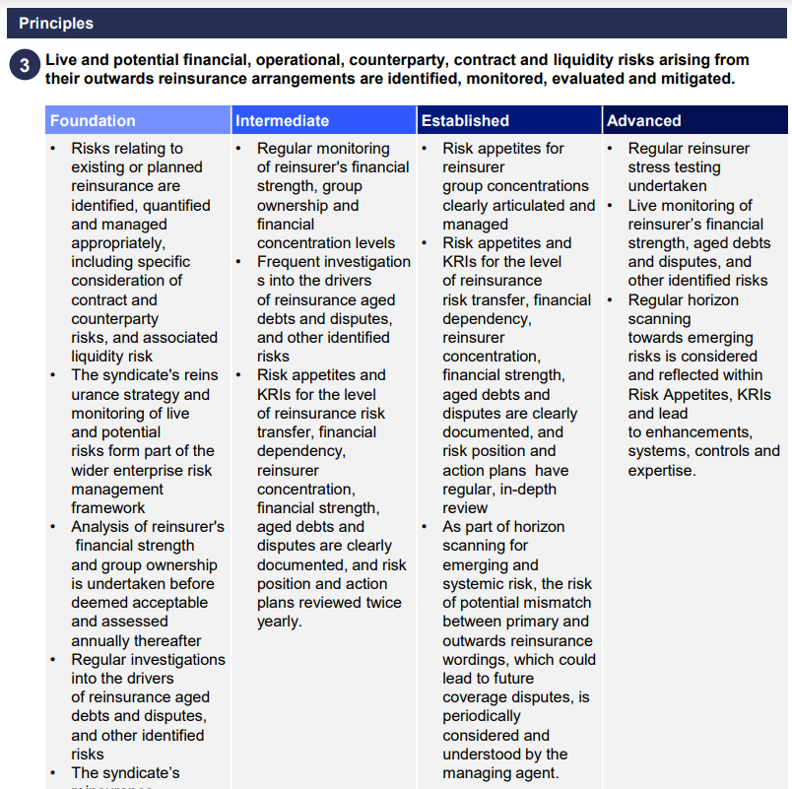
Case Study 2: Syndicate Y
Syndicate Y – Sub-Principle 3
Perceived outcomes
Syndicate Y has robust procedures in place for monitoring counterparty features including group concentrations, financial strength and aged debt.
How do we know this?
Syndicate Y has a long standing relationship with a Global Casualty Reinsurance group with various entities within the group having reinsured the programme over the past decade, owing to this Lloyd’s has asked the syndicate to provide the group level risk appetite statements and monitoring KRIs which the syndicate has done. Aged Debts are very low and the financial strength of both the group and the entities are monitored on a frequent basis.
Managing Agent rating
Expected Maturity – Foundational
Actual Maturity - Established

Slide 32
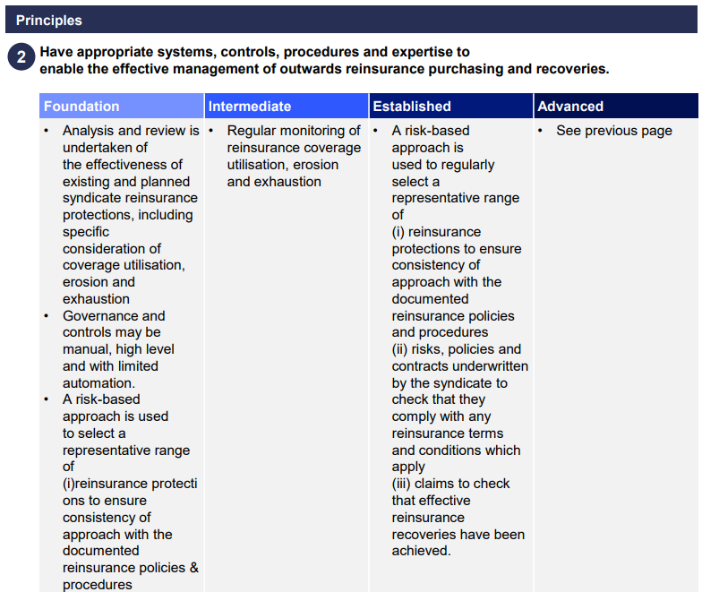
Case Study 2: Syndicate Y
Syndicate Y – Sub-Principle 2
Perceived outcomes
Whilst Syndicate Y has a consideration of forecast utilisation, erosion and exhaustion at the planning stage, it is not monitoring the shared programmes with appropriate regularity.
How do we know this?
QMB Reporting indicated an increase in Reinsurance Recoveries, a large portion of which were then removed the following quarter despite no movement in the gross claims. Upon investigation it emerged that the syndicate had not accounted for the utilisation of the coverage by the shared reinsurance contract party.
Managing Agent rating
Expected Maturity – Foundational
Actual Maturity - Foundational

Slide 33
Case Study 2: Syndicate Y
Principle |  | Expected Maturity | Assessment of Agent Maturity
3. Outwards Reinsurance Managing agents should define and execute syndicate outwards reinsurance strategy and purchasing plans which effectively support the wider syndicate business strategy and objectives. To support this, managing agents should ensure their syndicates': |  | Foundational | Foundational
Sub Principle 1 | Outwards reinsurance strategies and purchasing plans are robust and reflect underwriting, exposure and capital management / appetites of each individual syndicate, and the best interests of the members of the syndicate. | Foundational | Intermediate
Sub Principle 2 | Have appropriate systems, controls, procedures and expertise to enable the effective management of outwards reinsurance purchasing and recoveries. | Foundational | Foundational
Sub Principle 3 | Live and potential financial, operational, counterparty, contract and liquidity risks arising from outwards reinsurance arrangements are identified, monitored, evaluated and mitigated. | Foundational | Established
Sub Principle 4 | Have robust and effective monitoring, reporting and governance frameworks employed over their outwards reinsurance arrangements. | Foundational | Foundational
Overall Rationale
Syndicate Y has strong counterparty monitoring including group concentrations. However, it has failed to regularly monitor shared cessions to ensure that cover remains available when needed.
Overall, a Foundational level is appropriate at this time and the syndicate meets expectations.

Slide 34
Self-assessment submissions
Lyndsay Deeves

Slide 35
Principles self-assessments
Moving from prescription to outcomes focussed

Slide 36
What are the key differences between the “Attestation” and “self-assessment”?
Self-assessment, not Attestation
Best efforts basis
Submitting on a “best efforts” basis.
Formal Board sign off not required.
However, we would expect discussion at the Board
Working level
Will highlight any gaps in understanding the Principles.
Will provide a basis for discussion with Lloyd’s to “compare and contrast” managing agent vs Lloyd’s views against the Principles
We understand Principles will not be fully embedded.
Self-assessments will be an initial tool for your teams.
Boards should step back to consider if your teams have embraced the move away from “tickboxes” to an outcomes based approach

Slide 37
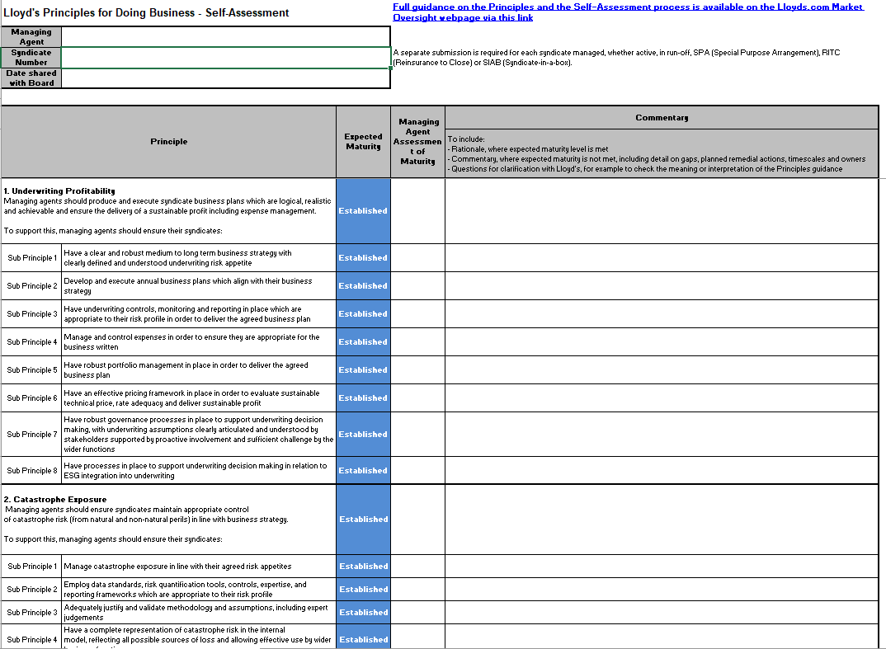

Slide 38
Self-assessment Principles rating
Principle 13: Culture
Principle |  | Expected Maturity | Managing Agent Assessment of Maturity | Commentary
 |  |  |  | To include: - Rationale, where expected maturity level is met - Commentary, where expected maturity is not met, including detail on gaps, planned remedial actions, timescales and owners - Questions for clarification with Lloyd's, for example to check the meaning or interpretation of the Principles guidance.
13. Culture Managing agents should be inclusive, creating a diverse and high-performance culture. |  | FOUNDATIONAL | BELOW FOUNDATIONAL | Overall Culture is currently Below Foundational. Plans are in place to address the gaps, starting with data, and strengthening how speaking up is managed. The Culture and Inclusion Advisory Group will take a lead role in reviewing firm culture and developing a culture plan, as a pillar of our strategy.
Sub Principle 1 | Demonstrate leadership focus on fostering an inclusive, high-performance culture​ | Foundational | Foundational | A Culture and Inclusion Advisory Group is being set up, led by Member of ExCo, who will undertake a culture review in 2022 and develop a culture plan, involving employees. The Advisory Group will report to the Board on progress
Sub Principle 2 | Ensure behaviour expectations are clear and there is zero tolerance for inappropriate behaviour | Foundational | Foundational | In Q4 2021 the code of conduct, which outlines behavioural expectations was communicated to all employees. It is also included in employee induction and forms part of annual mandatory training, along with mandatory diversity and inclusion training for all employees.
Sub Principle 3 | Encourage speaking up, ensuring there are appropriate tools for employees to do so, and the tone is set from the top​ | Foundational | Below Foundational | In 2021 a grievance related to sexual harassment was not handled well, resulting in the victim leaving the organisation. A review of how we manage grievances was undertaken by a law firm, who have provided recommendations that we started to implement in Q3 2021 which is ongoing. The case with the individual has been settled, with the perpetrator dismissed. We have run training for all employees and managers on how to raise concerns and how to respond when these matters are raised. We expect employee feedback on confidence to speak up and that management take concerns seriously to have improved in upcoming employee surveys
Sub Principle 4 | Ensure diverse representation within their workforce and their leadership population. Be inclusive in how they hire and retain talent and ensure they reflect society and their customers | Foundational | Foundational | % women in leadership is 22%, and we are quartile 2 against Lloyd’s market. Representation of ethnic minorities is unknown as we do not yet collect this data, but indications are it is also low. Our actions start with collecting data in H1 2022, which will be reviewed by the Culture and Inclusion Advisory Group to develop an action plan to improve diversity and inclusion.
Sub Principle 5 | Understand their employee population, collect appropriate data and take action to create an inclusive employee experience | Foundational | Foundational | Currently only gender data is collected. No other diversity data. HR system being upgraded and diversity data campaign to be run in H1 to collect broad diversity data including ethnicity, disability, sexual orientation, age .

Slide 39
Self-assessment Principles rating
Expected Maturity: Advanced
Actual Maturity: Advanced
Principle 10: Governance, Risk Management and Reporting
Principle |  | Expected Maturity | Agent assessment of Maturity | Commentary
 |  |  |  | To include: - Rationale, where expected maturity level is met - Commentary, where expected maturity is not met, including detail on gaps, planned remedial actions, timescales and owners - Questions for clarification with Lloyd's, for example to check the meaning or interpretation of the Principles guidance.
10. Governance, Risk Management and Reporting Managing agents should have governance structures and internal risk management and control frameworks in place which align to Solvency II requirements, enable sound and prudent management of the business and support delivery of the business strategy |  | ADVANCED | ADVANCED | As evidenced below, we have an appropriate and effective governance structure in place to ensure sound management of the business and compliance with all relevant requirements. A strong culture of good governance, effective risk management and independent challenge permeates throughout the business. The strategy and view from the top flows through all functions to enable their aims to align to the overall objectives of the business. Data, qualitative assessment and reporting is of high-quality, meaning decisions are built on strong foundations.
Sub Principle 1 | Manage a suitable board and committee structure which enables well informed, timely and accountable decision making | Advanced | Advanced | We have a well established and effective Board and committee structure, with track record of acting on independent advice and challenge. Strategy is routinely discussed and updated with input and ownership across the business. The effectiveness of Board and committees is regularly reviewed including periodic use of independent third parties. Our committee structure ensures that all business functions have appropriate Board or executive level committees with suitable reporting lines into the Board.
Sub Principle 2 | Operate a strong risk and control environment which allows for appropriate challenge | Advanced | Advanced | Risk culture is well embedded and demonstrated throughout the business. Risk Management views are clearly sought and help to drive decision making. All functions take active ownership for risk management activities and contribute to a continuous improvement process. This is lead top-down. Risk appetite is set by the Board and cascades throughout all risk metrics and monitoring activities, ensuring a link between functional level risk strategy/activities and the agreed appetites of the Board. A forward looking view of risk is considered highly important for how we assess, manage and discuss risk.
Sub Principle 3 | Maintain appropriate oversight of operational processes for effective management of the business | Advanced | Advanced | The Board has regular sight of KPI reporting on key operational processes and resourcing. This is routinely challenged and the KPIs and SLAs are reviewed and changed where necessary. We are confident in the overall operational infrastructure and efficacy, through the assurance as evidenced by the ongoing cycle of internal audits with timely follow-up of findings.
Sub Principle 4 | Employ and develop people with appropriate skillsets and ensure the business is appropriately resourced​ | Advanced | Advanced | We take development seriously with regular review of succession planning. Training, coaching and mentoring is actively provided to those identified as future leaders or key function holders. Staff engagement survey has consistently high scores for employee training and development. We promote an open and inclusive culture with a track record of acting on employee ideas.
Sub Principle 5 | Ensure decision making is supported by appropriate data and qualitative assessment | Advanced | Advanced | Information presented to the Board is consistent, accessible and highly informative. The manner in which information is presented is under a constant cycle of review and development. Complex data supports analyses and is presented in a format which supports effective decision making.
Sub Principle 6 | Maintain reporting, including all financial reporting, of a high quality and submit all reports in a timely, accurate and complete manner to Lloyd’s and to applicable regulators. | Advanced | Advanced | All reporting was submitted to Lloyd’s on time with a high accuracy. This has been verified by an internal monitoring process.

Slide 40
Next steps
Lyndsay Deeves
Notes:
So finally, a quick outline of our next steps.

Slide 41
Next Steps and Timeline
Syndicates complete and submit self assessments
(29 April)
Pre-populated self assessment templates uploaded (14 January)
Syndicate categorisation confirmed ahead of 2023 CPG
(June)
Jan - April
May – June
Jan
Ongoing support and engagement via Account Managers
Follow-up discussions with syndicates re differences in view
Technical briefings held
Lloyd’s complete assessments of syndicates
Notes:
The self-assessment templates should already be available to you, now, for downloading and completing.
Over the next few months, we'll be converting our CROF processes and assessments for all syndicates into ratings against the principles. And then syndicates will submit their self assessments at the end of April.
Over May and June we'll reconcile your assessments with ours, and discuss any differences in opinions, before finalising syndicates' categorisations before the business planning cycle begins.

Slide 42
What should you be doing?
Familiarise yourself with the Principles and guidance
Consider any upskilling required to successfully adopt the new Principles based regime
Review expected maturity as communicated in Oversight Letters
Speak to your Account Manager if you have any questions
Conduct the self-assessment – be open, transparent and thorough
Guidance and templates are now on SecureShare
Oversight Framework team available to answer any questions
Consider what actions can be taken to close any gaps before mid-year
Questions on the new framework should be directed to your Account Manager or oversight.framework@lloyds.com in the first instance ​
​
​
Do use the support available from Lloyd’s!
Notes:
So for now, these are the takeaways, the call to action.
Please get familiar with the Principles, and the Nat Cat maturity framework to the extent that it's set out slightly differently to CROF.
Consider whether you're going to have any difficulties adjusting to the new regime.
Check your expected maturity, start completing the self-assessment, and then think about whether there might be any gaps that can be easily closed.
For any questions on the framework, get in touch with your syndicate's Account Manager – not your Exposure Management Manager.
And do think about preparing for our detailed non-nat cat reviews, coming in April onwards! Your EM Manager will be in touch about that.

Slide 43
Q&A

